Slide 1
TMDB Box Office Prediction
第四組
組長 :
110302001 陳爰方
組員 :
108401006 吳花瑜、110202005 陳宇倫 、
110202531 陳戎祿、110302016 呂侑勳

Slide 2
Table of contents
０１
基本資訊
０４
使用者介面實作
０２
資料前處理
０５
總結
０３
模型選用

Slide 3
01
budget int64
id int64
runtime float64
revenue float64
popularity float64
Keywords object
status object
spoken_languages object
release_date object
production_countries object
production_companies object
poster_path object
overview object
original_title object
original_language object
imdb_id object
homepage object
genres object
crew object
cast object
belongs_to_collection object
tagline object
title
題目背景說明
本次預測是從電影數據庫中 7,000 多部過去電影的元數據，嘗試預測它們的全球總票房收入。
提供的數據資料包括演員、工作人員、情節關鍵詞、預算、海報、發行日期、語言、製作公司和國家等。

Slide 4
分工表
資料前處理 | 110202005 陳宇倫 、108401006 吳花瑜
模型預測 | 110302001 陳爰方、110302016 呂侑勳
前端 | 110202531 陳戎祿

Slide 5
02
資料前處理
前半部

Slide 6
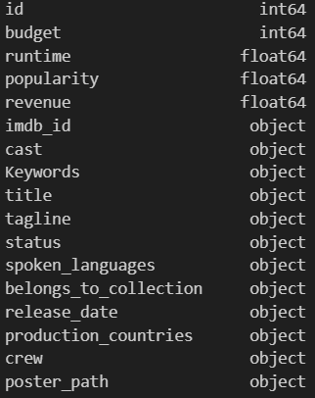

Observe the raw data

Slide 7
Observe the raw data
number
Object

Slide 8


Observe data typed object
Production companies
Spoken languages
Production countries
Keywords

Slide 9
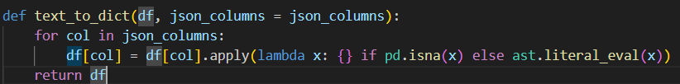
Production companies
[{'name': 'Paramount Pictures', 'id': 4}, {'name': 'United Artists', 'id': 60}, {'name': 'Metro-Goldwyn-Mayer (MGM)', 'id': 8411}]
Nan

Slide 10
Production companies
dictionary
[{'name': 'Paramount Pictures', 'id': 4}, {'name': 'United Artists', 'id': 60}, {'name': 'Metro-Goldwyn-Mayer (MGM)', 'id': 8411}]
[{'name': 'Paramount Pictures', 'id': 4}, {'name': 'United Artists', 'id': 60}, {'name': 'Metro-Goldwyn-Mayer (MGM)', 'id': 8411}]
Nan
{ }

Slide 11
Production companies
[{'name': 'Paramount Pictures', 'id': 4}, {'name': 'United Artists', 'id': 60}, {'name': 'Metro-Goldwyn-Mayer (MGM)', 'id': 8411}]
list(['Paramount Pictures', 'United Artists', 'Metro-Goldwyn-Mayer (MGM)'])

Slide 12



Production companies - top 15

Slide 13

Production companies - top 15
Movie
A | 1 | 1
B | 0 | 0

Slide 14
Observe data typed float or integer
Popularity
Budget
runtime

Slide 15
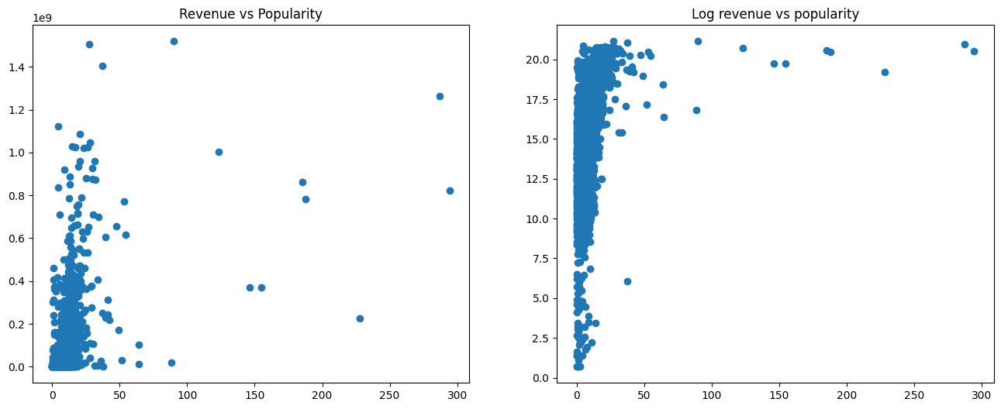
Popularity
Popularity & revenue
Popularity & log revenue
1e9
revenue
log revenue
Popularity
Popularity

Slide 16
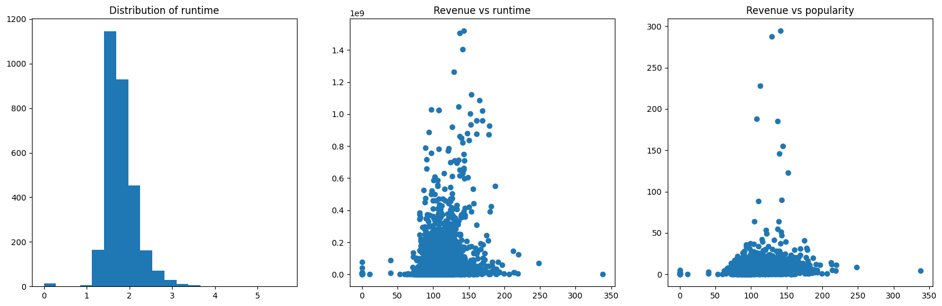
Runtime
numbers
revenue
Runtime (hour)
Runtime (minute)

Slide 17
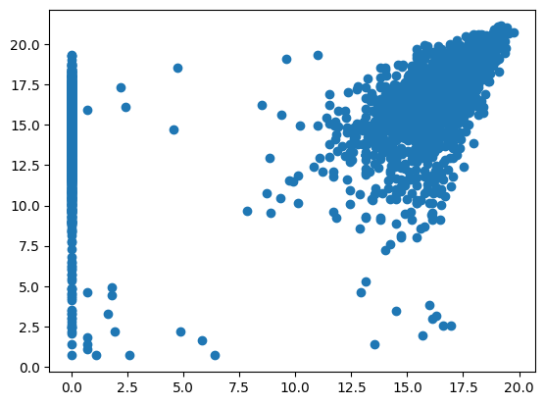
Budget
Log budget & log revenue
log revenue
Log budget

Slide 18
Improvement-Popularity
Popularity & log revenue
log revenue
Popularity

Slide 19
02
資料前處理
後半部
belongs_to_collection, genres, homepage, original_language, original_title, imdb_id, overview, tagline, title, cast, crew

Slide 20
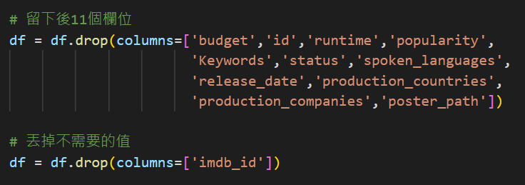
留下需要處理的欄位

Slide 21
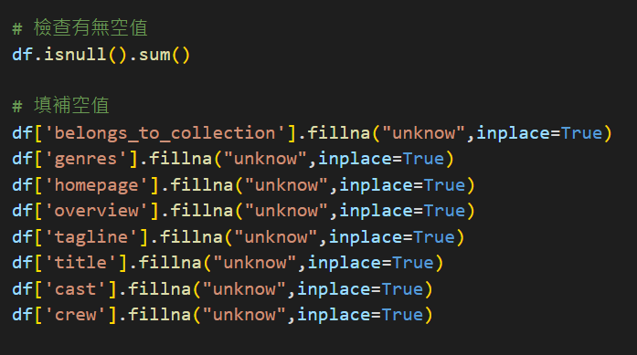
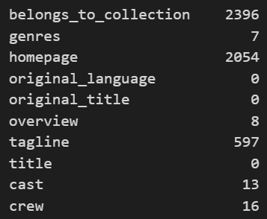
檢查有無空值並填補空值

Slide 22
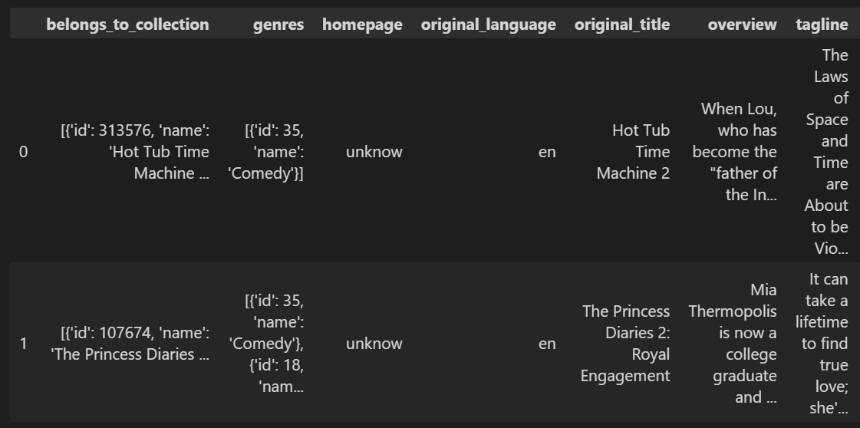
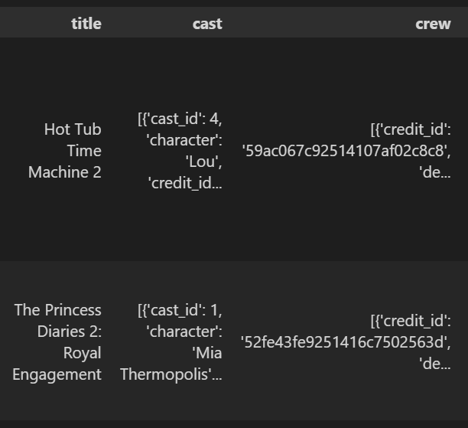
看前兩筆資料

Slide 23
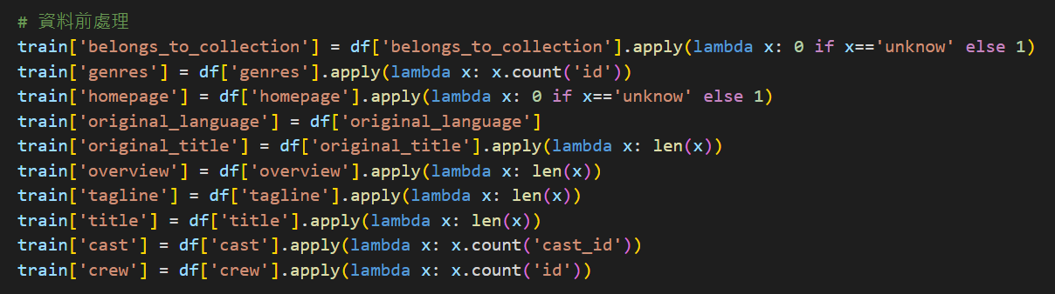
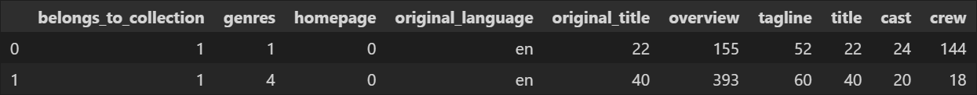
資料前處理並觀察前兩筆資料

Slide 24
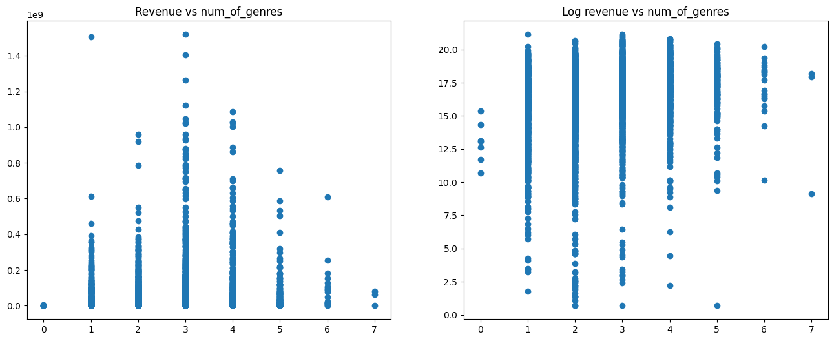
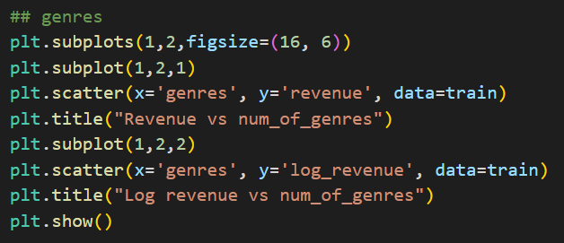
畫圖觀察
收入與電影類別的關係

Slide 25
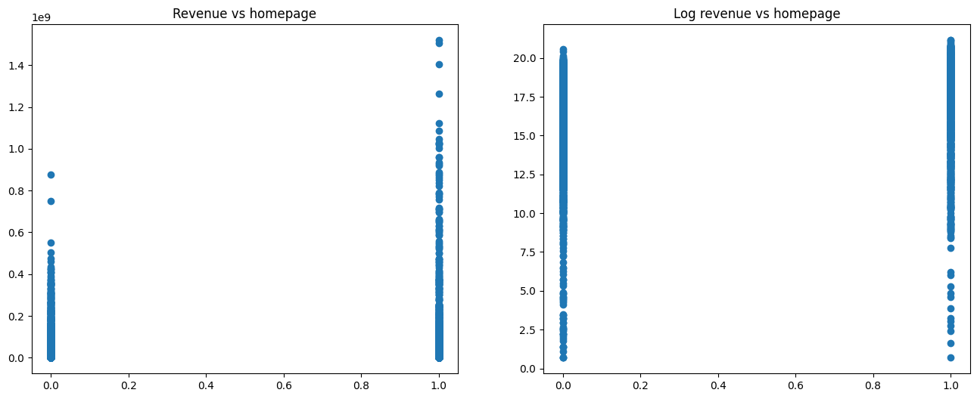
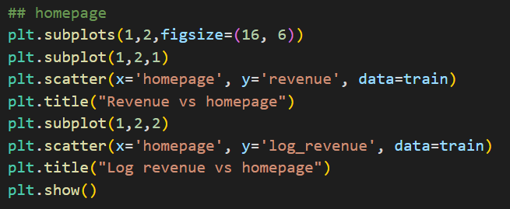
畫圖觀察
收入與有無首頁的關係

Slide 26
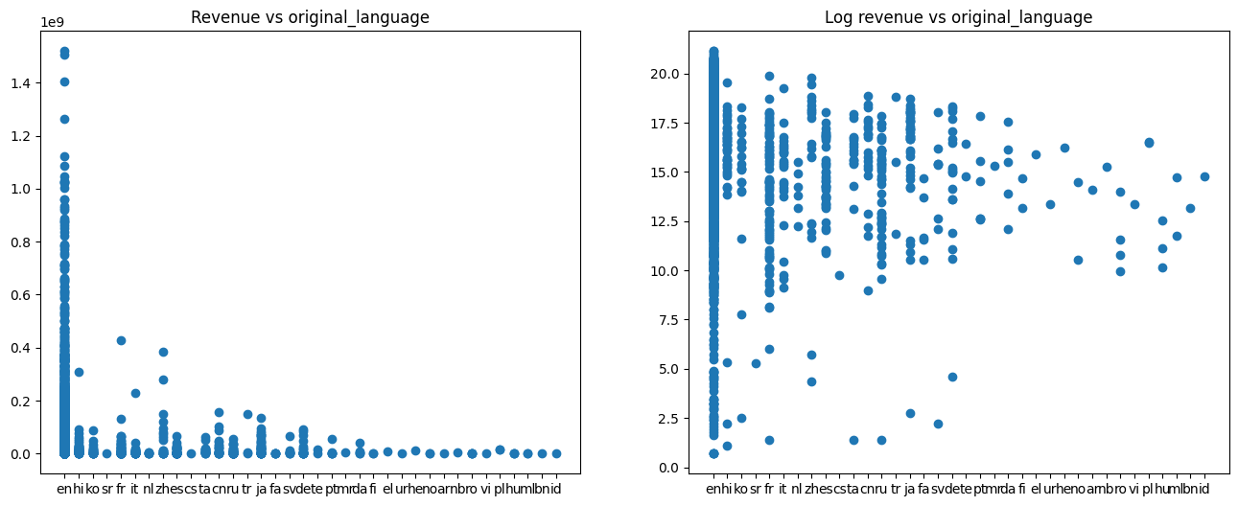
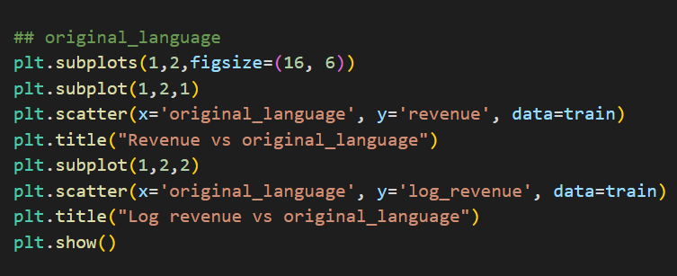
畫圖觀察
收入與原始語言的關係

Slide 27
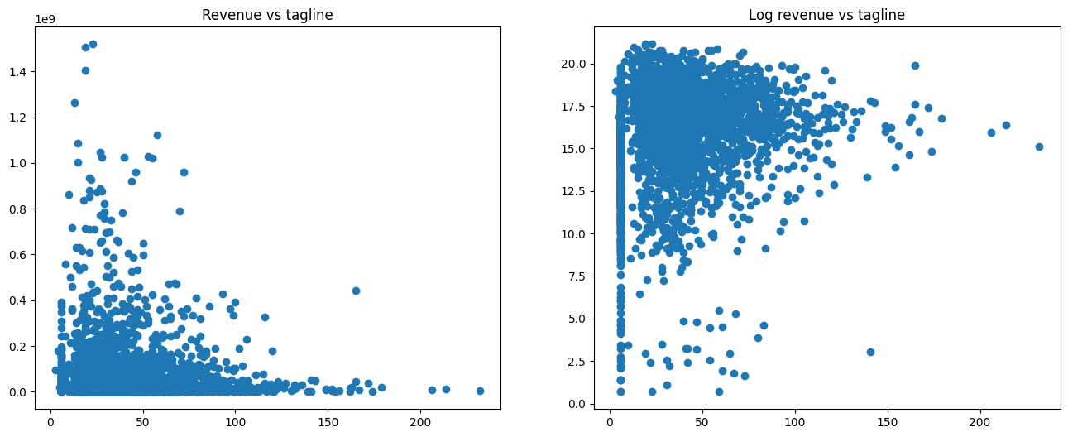
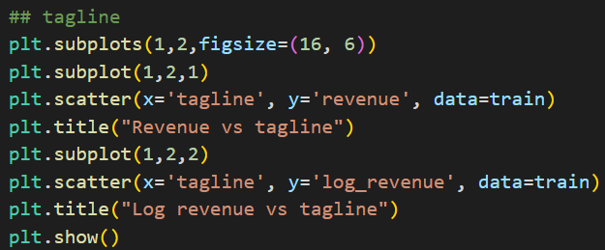
畫圖觀察
收入與標語字數的關係

Slide 28
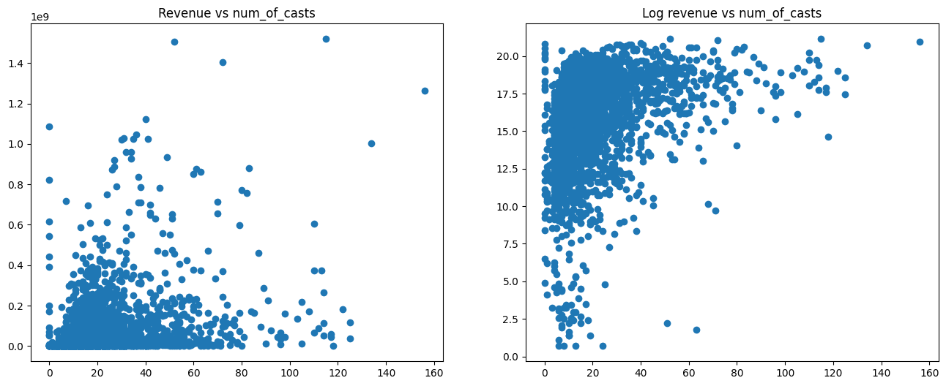
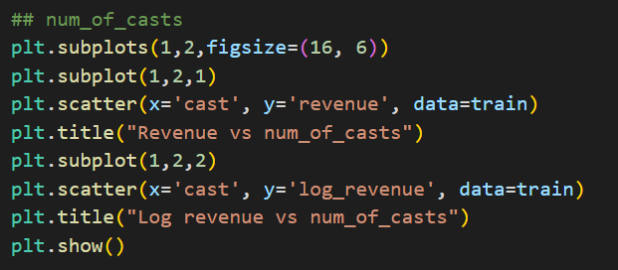
畫圖觀察
收入與演員人數的關係

Slide 29
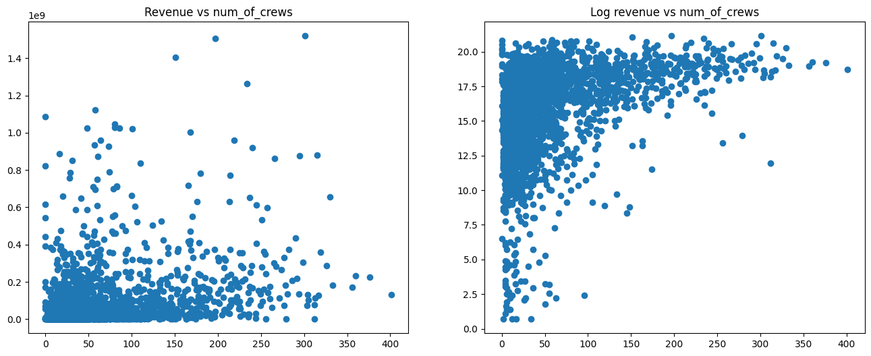
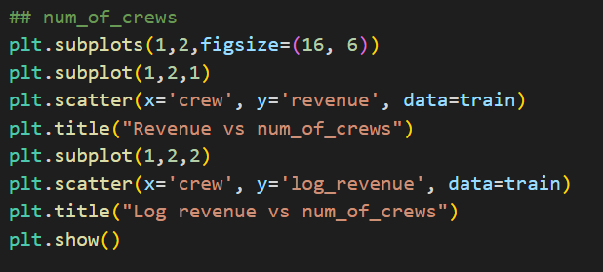
畫圖觀察
收入與團隊人數的關係

Slide 30
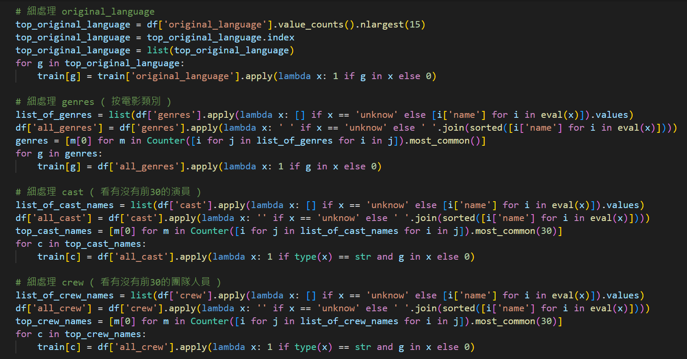
仔細處理原始語言及電影類別

Slide 31
仔細處理演員及團隊成員

Slide 32
03
模型選用

Slide 33
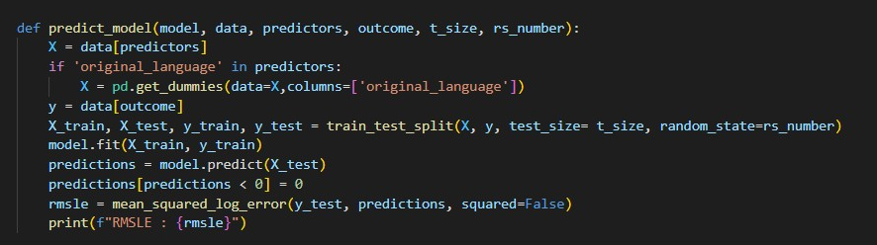
定義預測模型&準確值
You can give a brief description of the topic you want to talk about here. For example, if you want to talk about Mercury, you can say that it’s the smallest planet in the entire Solar System

Slide 34
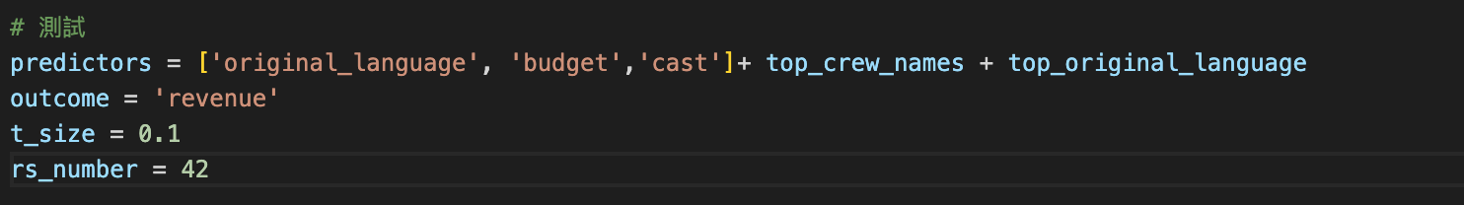
參數設定

Slide 35
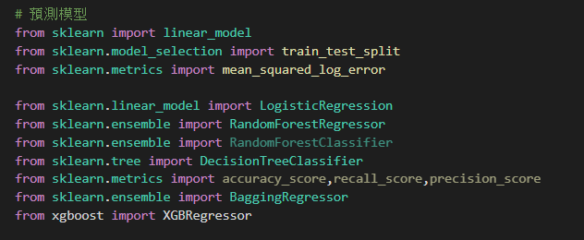
匯入相關模組

Slide 36
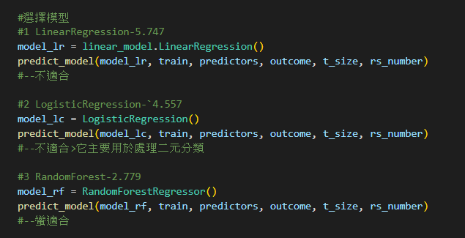
預測模型選用

Slide 37
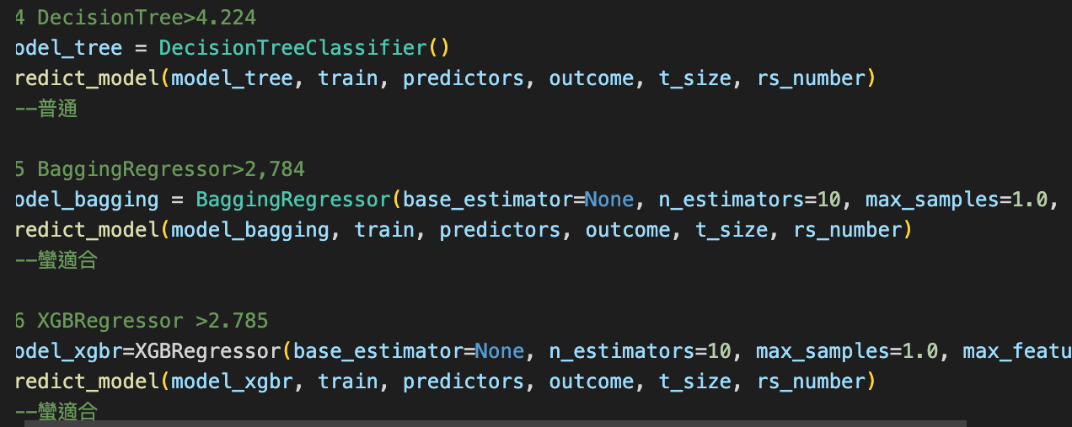
預測模型選用
=============>>>>>>>>結論用RandomForestRegressor

Slide 38
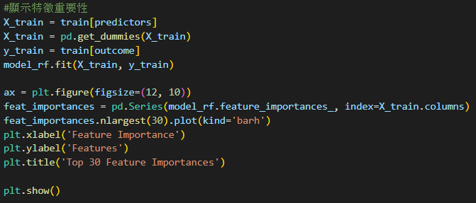
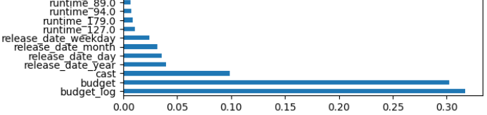
顯示各特徵重要性

Slide 39
使用多種變數
#試試各種預測參數
model_rf = RandomForestRegressor()
outcome = 'revenue'
predictors = ['crew','original_language','budget','cast','popularity'] + top_crew_names + top_original_language
predict_model(model_rf, train, predictors, outcome, t_size, rs_number)
#>2.597
predictors= ['original_language','budget','cast','runtime'] + top_spoken_languages + top_crew_names + top_original_language
predict_model(model_rf, train, predictors, outcome, t_size, rs_number)
#>2.579-----

Slide 40
使用多種變數
predictors=['original_language', 'budget_log', 'cast', 'runtime',
'release_date_year', 'release_date_month','release_date_day', 'release_date_weekday', 'budget_log', 'revenue_mean', 'revenue_max']+ top_crew_names
predict_model(model_rf, train, predictors, outcome, t_size, rs_number)
#>多沒有比較好:(
predictors=['original_language','budget_log', 'cast', 'runtime', 'release_date_year']
predict_model(model_rf, train, predictors, outcome, t_size, rs_number)
#>2.575
predictors=['original_language','budget_log', 'cast', 'runtime']
predict_model(model_rf, train, predictors, outcome, t_size, rs_number)
#>2.56

Slide 41
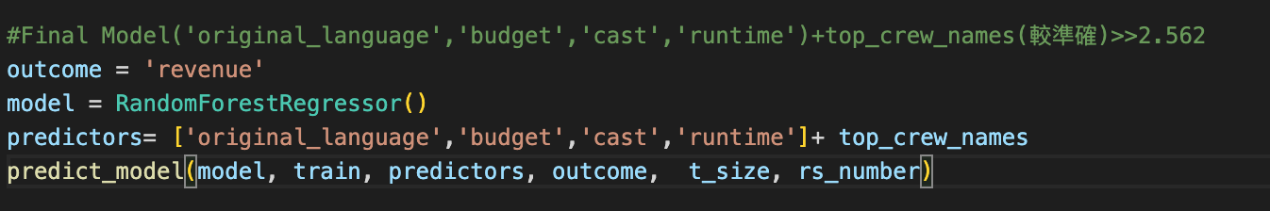
最終模型

Slide 42
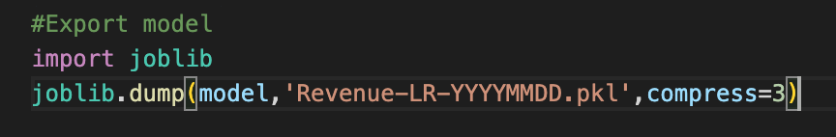
匯出pkl檔傳給前端

Slide 43

User Interface
2023
04
使用者介面實作

Slide 44


UI

Slide 45



https://streamlit.io/

Slide 46
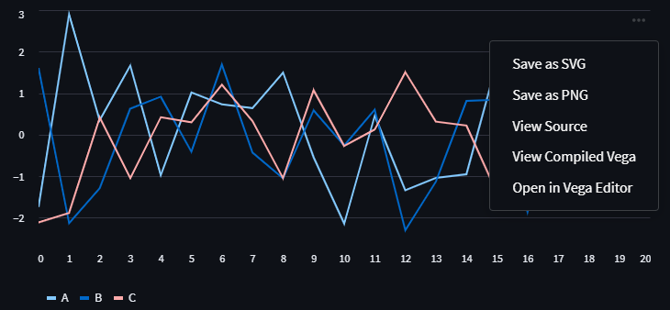
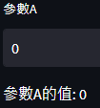
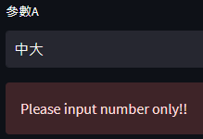
data=pd.DataFrame(
np.random.randn(20,3),
columns=["A","B","C"])
st.line_chart(data)
direct_input = st.text_input('參數A', value='0', key='direct_input_a')
try:
a = float(direct_input)
st.write('參數A的值:', direct_input)
except ValueError:
st.error('Please input number only!!')

Slide 47
Cast, Budget, Runtime
Natural number
Original language, Crew
List

Slide 48
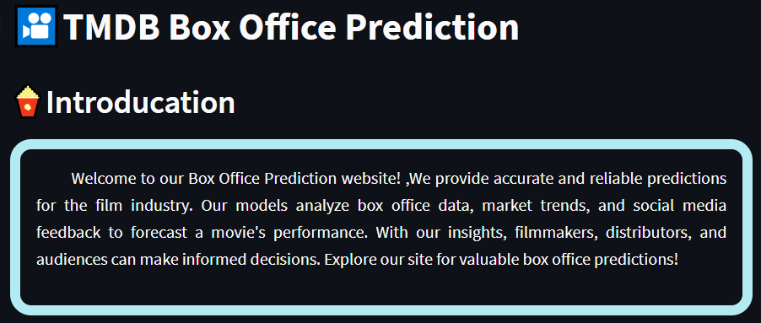
st.markdown("# 🎦TMDB Box Office Prediction")
#------------------------------------------------------
## Introducation
st.markdown("## **🍿Introducation**")
### Introducation Text
intro_text = """
&nbsp; &nbsp; &nbsp; &nbsp; Welcome to our
Box Office Prediction website! ,…………
"""
### Introducation form
styled_text = f"""
<div style='border: 10px solid #B2EBF2;
padding: 15px; border-radius: 20px; text-align: justify;'>
{intro_text}
</div>
"""
st.markdown(styled_text, unsafe_allow_html=True)

Slide 49
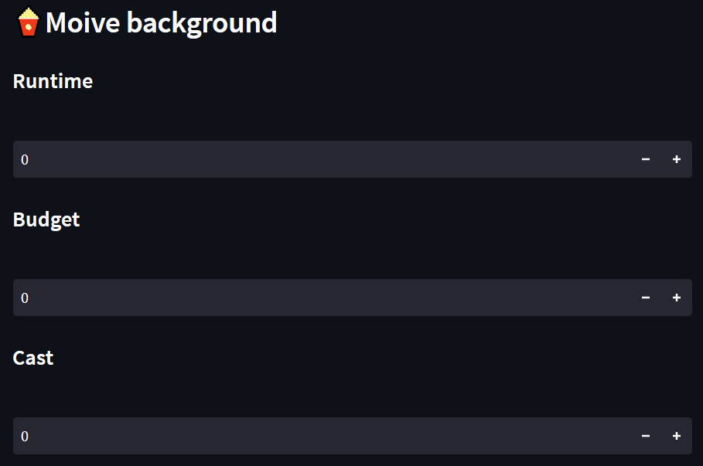
## Moive background
st.markdown("## **🍿Moive background**")
####===================輸入Runtime==============
st.markdown("#### Runtime")
Runtime = st.number_input(" ", value=0)
st.markdown("#### Budget")
Budget = st.number_input(" ", value=0)
####===================Cast=====================
st.markdown("#### Cast")
Cast = st.number_input("", value=0)

Slide 50
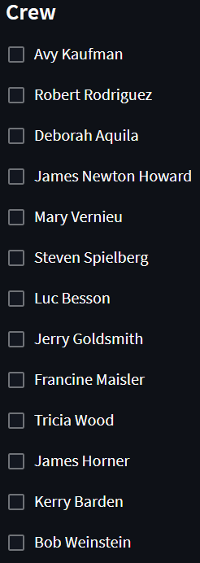
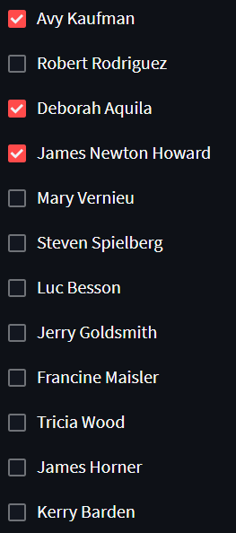
st.markdown("#### Crew")
crew = ['Avy Kaufman', 'Robert Rodriguez’, ……]
Crew = []
for i in range(len(crew)):
a = st.checkbox(crew[i])
if a:
Crew.append(1)
else:
Crew.append(0)
Crew=[1,0,1,1,………..]

Slide 51

st.markdown("#### Original language")
# Language = st.selectbox(
# 'What is the original language?',
ln = ['ar', 'bn', 'cn', 'cs', 'da', 'de', 'el', 'en', 'es', 'fa', 'fi', 'fr', 'he', 'hi', 'hu', 'id', 'it', 'ja', 'ko', 'ml', 'mr', 'nb', 'nl', 'no', 'pl', 'pt', 'ro', 'ru', 'sr', 'sv', 'ta', 'te', 'tr', 'ur', 'vi', 'zh']
language_dict = {
'ar': 'Arabic','bn': 'Bengali', 'cn': 'Chinese','cs': 'Czech',
'da': 'Danish', 'de': 'German', 'el': 'Greek', 'en': 'English',
'es': 'Spanish', 'fa': 'Persian', 'fi': 'Finnish', 'fr': 'French',
'he': 'Hebrew', 'hi': 'Hindi', 'hu': 'Hungarian', 'id': 'Indonesian',
'it': 'Italian', 'ja': 'Japanese', 'ko': 'Korean', 'ml': 'Malayalam',
'mr': 'Marathi', 'nb': 'Norwegian', 'nl': 'Dutch', 'no': 'Norwegian',
'pl': 'Polish', 'pt': 'Portuguese', 'ro': 'Romanian','ru': 'Russian',
'sr': 'Serbian', 'sv': 'Swedish', 'ta': 'Tamil', 'te': 'Telugu',
'tr': 'Turkish', 'ur': 'Urdu', 'vi': 'Vietnamese', 'zh': 'Chinese’
}
language_names = [language_dict.get(code, code) for code in ln]

Slide 52
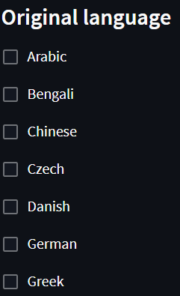
Language= []
for i in range(len(ln)):
b = st.checkbox(language_names[i], key=f"checkbox_{ln[i]}")
if b:
Language.append(1)
else:
Language.append(0)
Language=[1,0,0,0,………..]

Slide 53
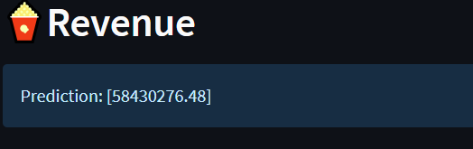
## Prediction
st.markdown("## **🍿Revenue**")
# 加载预训练的模型
model_pretrained = joblib.load('Revenue-LR-YYYYMMDD.pkl')
# 创建特征列表
features = [[Budget] + [Cast] + [Runtime] + Crew+Language]
prediction = model_pretrained.predict(features)
st.info("Prediction: " + str(prediction))

Slide 54
05
總結

Slide 55
summary
Observation &
data processing
Testing & revising module
Build up user interface

Slide 56

Thanks for listening

